Slide 1
Statistics
Basics - 1

Slide 2
Statistics
the term statistics refers to numerical facts such as
averages,
medians, percents
, and index numbers
that help us understand a variety of business and economic situations

Slide 3
Statistics
However, as you will see, the field, or subject, of statistics involves much more than numerical facts.
In a broader sense, statistics is defined as the
Art and Science of - CAPI
collecting,
analyzing,
presenting,
and interpreting data.

Slide 4
Managers ( Top level) and decision makers a better understanding of the business
and economic environment
Enables them to make more informed and better decisions

Slide 5
Typical Terms
Data
Elements
Variables
Observations
Sample
Population
Measurements

Slide 6
Uses in …
Accounts – Auditing – Sample
Financial – Stocks, Price, Profits etc.
Marketing – Success/failure, strategy
Production – Manufacturing, Quality, Forecast
Scientific Research – Biology, Medicine, Engineering, Physics, chemsitry
Social Science – Psychology, History, War , Sports

Slide 7
Data – Data Set
Data are the facts and figures collected, analyzed, and summarized for presentation and interpretation.
All the data collected in a particular study are referred to as the data set for the study

Slide 8
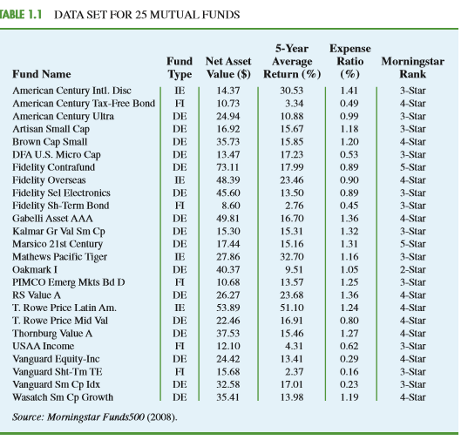

Slide 9
Elements
Elements are the entities on which data are collected.
Each individual mutual fund is an element: the element names appear in the first column. With 25 mutual funds, the data set contains 25 elements

Slide 10
Variable
A variable is a characteristic of interest for the elements.
Eg: 5 Variables in our data set
Fund Type: The type of mutual fund, labeled DE (Domestic Equity), IE (International Equity), and FI (Fixed Income)
• Net Asset Value ($): The closing price per share

Slide 11
Observations
Measurements collected
on each variable
for every element in a study provide the data.
The set of measurements obtained for a particular element is called an observation
Example : Each Row is equal to 1 Observation

Slide 12
scales of measurement
Data collection requires one of the following scales of measurement:
Nominal,
Ordinal,
Interval,
Ratio

Slide 13
Nominal
labels or names used to identify an attribute of the element, the scale of measurement is considered a nominal scale.
For example, referring to the data in Table 1.1, we see that the scale of measurement for the Fund Type variable is nominal because DE, IE, and FI are labels used to identify the category or type of fund.
In cases where the scale of measurement is nominal, a numeric code as well as nonnumeric labels may be used.
Category – Numeric, Non Numeric

Slide 14
Nominal
For example, to facilitate data collection and to prepare the data for entry into a computer database, we might use a numeric code by letting
1 denote Domestic Equity,
2 denote International Equity,
3 denote Fixed Income.
In this case the numeric values 1, 2, and 3 identify the category of fund. The scale of measurement is nominal even though the data appear as numeric values. - Category

Slide 15
Ordinal
The scale of measurement for a variable is called an ordinal scale
if the data exhibit the
properties of nominal data
the order or rank of the data is meaningful.
Eg: Customer Satisfaction Survey
For example, Eastside Automotive sends customers a questionnaire designed to obtain data on the quality of its automotive repair service. Each customer provides a repair service rating of excellent, good, or poor. Because the data obtained are the labels—excellent, good, or poor—the data have the properties of nominal data. In addition, the data can be ranked, or ordered, with respect to the service quality. Data recorded as excellent indicate the best service, followed by good and then poor. Thus, the scale of measurement is ordinal.
Look Like category, but we can make a rank or order
Eg: in table 1.1 “Morningstar Rank” for the data

Slide 16
interval
The scale of measurement for a variable is an interval scale if the data have all the properties of ordinal data and the interval between values is expressed in terms of a fixed unit of measure.
Interval data are always numeric.
Scholastic Aptitude Test (SAT) scores are an example of interval-scaled data.
For example, three students with SAT math scores of
620, 550, and 470 can be ranked or ordered in terms of best performance to poorest performance.
In addition, the differences between the scores are meaningful. For instance, student 1 scored 620 550 70 points more than student 2, while student 2 scored 550 470 80 points more than student 3.
Interval of categories

Slide 17
Ratio scale
The scale of measurement for a variable is a ratio scale
if the data have
all the properties of interval data and
the ratio of two values is meaningful. Variables such as distance, height, weight, and time use the ratio scale of measurement
Comparable Values

Slide 18
Categorical or Quantitative
Data that can be grouped by specific categories are referred to as categorical data.
Categorical data use either the nominal or ordinal scale of measurement.
Data that use numeric values to indicate how much or how many are referred to as quantitative data.
Quantitative data are obtained using either the interval or ratio scale of measurement.

Slide 19
A categorical variable is a variable with categorical data, and
a quantitative variable is a variable with quantitative data
Arithmetic operations provide meaningful results for quantitative variables
Categories are for Grouping

Slide 20
cross-sectional data & time series data
Cross-sectional data are data collected at the same or approximately the same point in time.
Time series data are data collected over several time periods.
For example, the time series in Figure 1.1 shows the U.S. average price per gallon of conventional regular gasoline between 2006 and 2009.
Graphs of time series data are frequently found in business and economic publications. Such graphs help analysts understand what happened in the past, identify any trends over time, and project future levels for the time series.

Slide 21
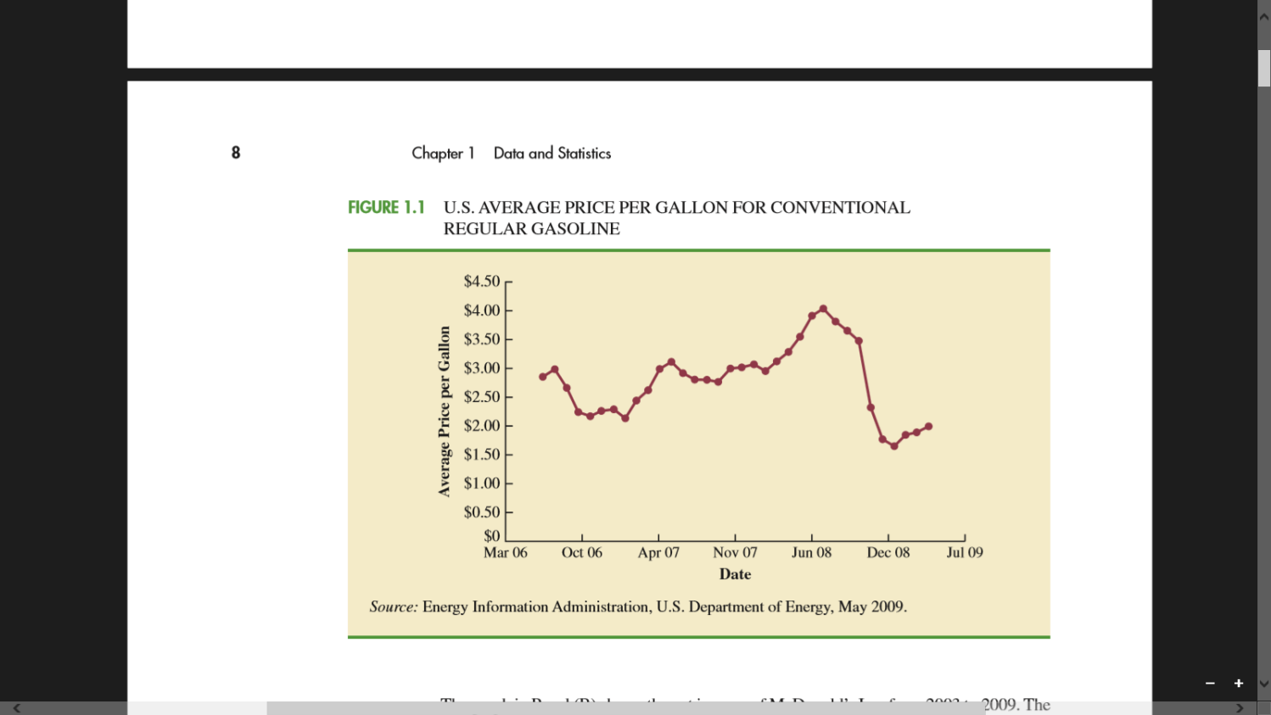
Time Series

Slide 22
Discrete or Continuous
Quantitative data may be discrete or continuous.
Quantitative data that measure how many (e.g., number of calls received in 5 minutes) are discrete.
Quantitative data that measure how much (e.g., weight or time) are continuous because no separation occurs between the possible data values.

Slide 23
Data Source
from existing sources - Historical
from surveys
experimental studies designed to collect - New data.

Slide 24
Data on sales, advertising expenditures, distribution costs, inventory levels, and production quantities – Already existing.
Purchase from 3rd party Vendors for Credit Card Rating data.
Specific Organization Like Travel, Education industry have their own set of data.

Slide 25
the data can often be obtained by conducting a statistical study.
Statistical studies can be classified as either experimental or observational.
For example, a pharmaceutical firm might be interested in conducting an experiment to learn about how a new drug affects blood pressure. Blood pressure is the variable of interest in the study

Slide 26
Nonexperimental, or observational, statistical studies make
no attempt to control the variables of interest.
An survey is perhaps the most common type of observational study.
For instance, in a personal interview survey, research questions are first identified.
Then a questionnaire is designed and administered to a sample of individuals.
Some restaurants use observational studies to obtain data about customer opinions on the quality of food, quality of service, atmosphere, and so on.

Slide 27
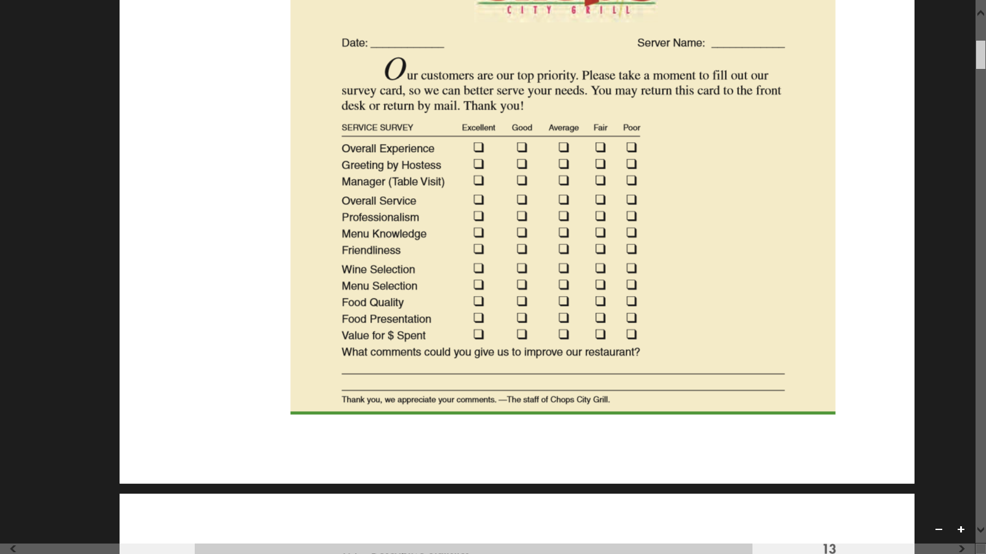
Survey

Slide 28
If important data are not readily available from an existing source, the additional time and cost involved in obtaining the data must be taken into account.

Slide 29
Data Acquisition Error
1. Miss spelling 24 / 42
2. Wrong questions, not understood well with the customer
Data should be taken with Care and due diligence. ( All norms and process)

Slide 30
Descriptive statistic
Data that are
summarized and
presented in a form that is easy for the reader to understand.
Such summaries of data, which may be tabular, graphical, or numerical.

Slide 31
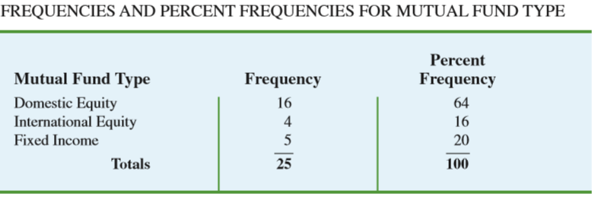
Descriptive

Slide 32
Statistical Inference Population - Sample
The larger group of elements in a particular study is called the population,
and the smaller group is called the sample.
POPULATION A population is the set of all elements of interest in a particular study.
SAMPLE A sample is a subset of the population.

Slide 33
Sample -> Population
The process of conducting a survey to collect data for the entire population is called a census.
The process of conducting a survey to collect data for a sample is called a sample survey.
As one of its major contributions, statistics uses data from a sample to make estimates and test hypotheses about the characteristics of a population through a process referred to as statistical inference.

Slide 34
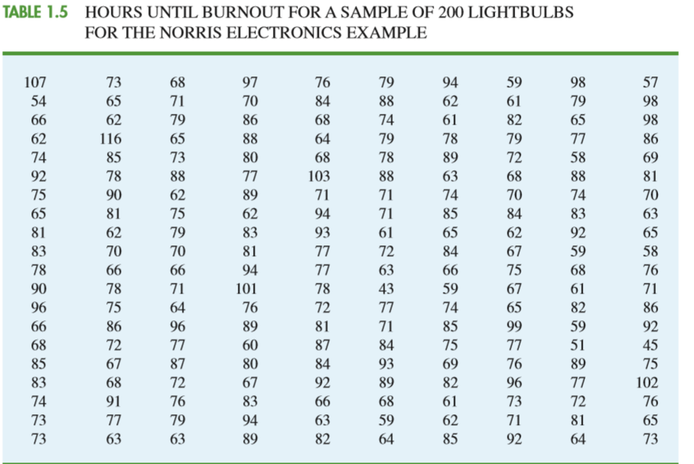
Sample – Eg: Bulbs experiment

Slide 35
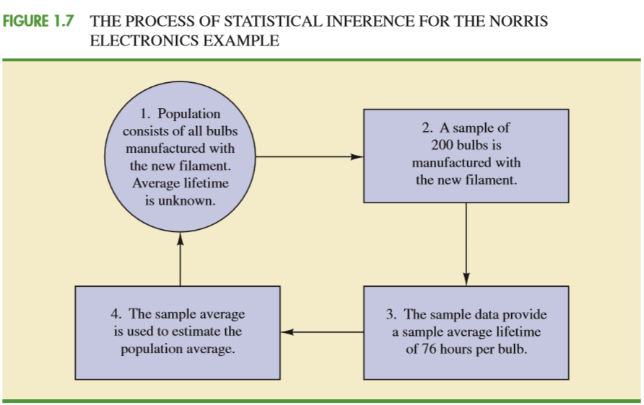

Slide 36
Point estimate of the average lifetime for the population of new lightbulbs is 76 hours with a margin of error of 4 hours. Thus, an interval estimate of the average lifetime for all lightbulbs produced with the new filament is 72 hours to 80 hours.

Slide 37
The term data warehousing is used to refer to the process of capturing, storing, and maintaining the data.
Computing power and data collection tools have reached the point where it is now feasible to store and retrieve extremely large quantities of data in seconds.

Slide 38
Data Mining
The subject of data mining deals with methods for developing useful decision-making information from large data bases. Using a combination of procedures from statistics, mathematics, and computer science, analysts “mine the data” in the warehouse to convert it into useful information, hence the name data mining

Slide 39
Artificial intelligence
machine learning to make data mining effective.
Predictive models

Slide 40
unethical behavior
In a statistical study, unethical behavior can take a variety of forms including improper sampling, inappropriate analysis of the data, development of misleading graphs, use of inappropriate summary statistics, and/or a biased interpretation of the statistical results.
If the study is repeated enough times, a sample may eventually be obtained—by chance alone—that would provide the desired result and enable Norris ( Bulb) to make such a claim.

Slide 41
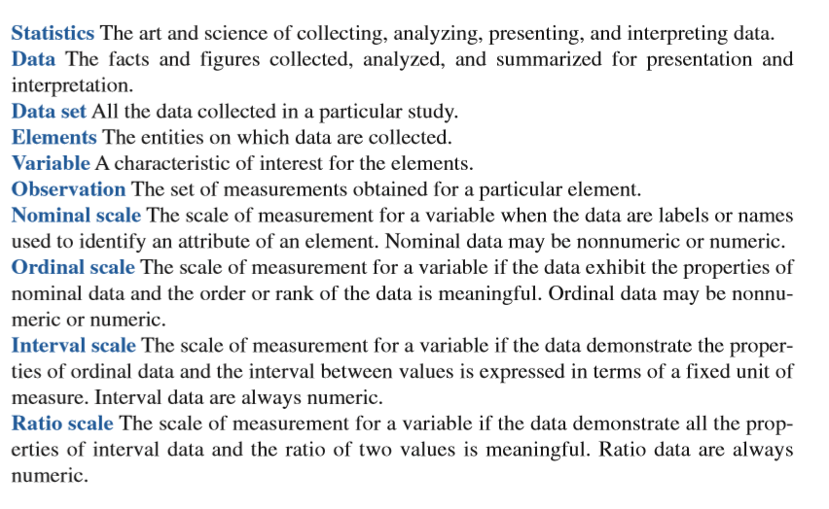

Slide 42
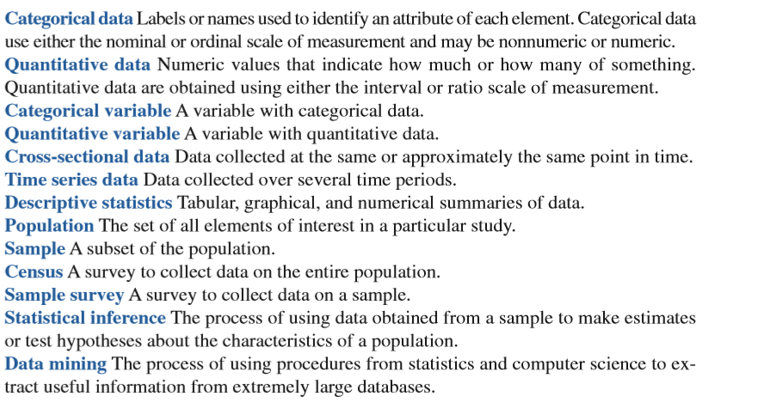

Slide 43
